Slide 1
Bibliographic Citation and Referencing
Research Methods in Management

Slide 2
Academic Integrity
Academic Integrity means that you give complete and fair credit to the sources of the ideas you incorporate in your paper.
Plagiarism
Plagiarism is a Latin word means “to kidnap”
For example:
Copy another author’s sentence word-by-word and presenting them as yours.
Present another person’s ideas or logical arguments as yours without citing the source.

Slide 3
Academic Integrity
How to avoid Plagiarism
Paraphrase or write the content in your own words.
Cite the sources of the information that are used in the report.

Slide 4
Citation and Referencing Styles
There are many styles of formatting citation and referencing
APA
MLA
Chicago
Harvard
Turabian
IEEE
Etc.
is the style that is used by NIDA
APA style (American Psychological Association) is developed by Social and behavioral scientist to standardize scientific writing and referencing.

Slide 5
Citation and Referencing
In-text “Citation”
An in-text citation gives the author of the source and the year of publication in parentheses
Entry in the list of “References”
At the end of the paper, a list of references provides publication information about the source

Slide 6
Citation and Referencing
In-text “Citation”: examples
Sammy (2012) mentioned that….
According to Newton (1984)….
This idea is supported by William (2014)’s research.
A study showed that support from supervisor can affect performance of employees (Sammy, 2012).
Positive parenting style can have high impact on life success of children (Newton, 1984).
Organizational change can make employees experience stress (William, 2014)

Slide 7
Citation and Referencing
In-text “Citation”
Last name of the author (publication year)
Or
(Last name of the author, publication year)
For examples:
According to Thomas (2006), mindfulness was proposed as a factor that can help people develop cultural intelligent skills.
Mindfulness was proposed as a factor that can help people develop cultural intelligent skills (Thomas, 2006).

Slide 8
Citation and Referencing
Required information for journal article
Author’s full name
Year of publication
Title of the paper
Journal name
Volume
Issue (or number)
Page range (from what page to what page)
Doi (Digital Object Identifier)
Usually start with “http://doi.org/”...then numbers

Slide 9
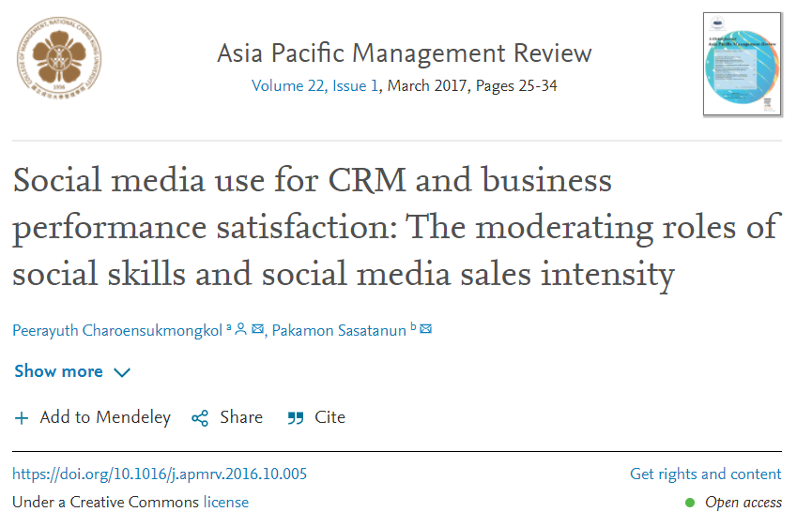
Citation and Referencing
Page range
Journal name
Volume and Issue
Year of publication
Title of the paper
Authors’ full names
Doi

Slide 10
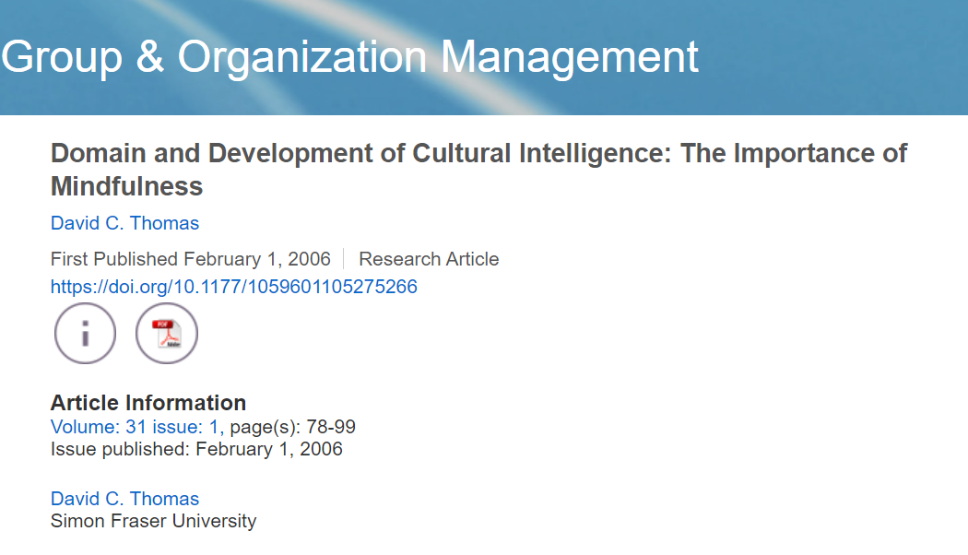
Citation and Referencing
Journal name
Author’s full name
Title of the paper
Doi
Page range
Volume and Issue
Year of publication

Slide 11
Citation and Referencing
Entry in the list of “References”
Last name of the Author, Initials of first name and middle name (publication year). Name of the article. Journal name, Volume(Issue or Number), page range. doi.
Example:
Thomas, D.C. (2006). Domain and Development of Cultural Intelligence: The Importance of Mindfulness. Group & Organization Management, 31(1), 78-99. https://doi.org/10.1177/1059601105275266

Slide 12
Citation and Referencing
In-text “Citation” – 2 authors
Miller and Shamsie (1996) suggested that…..
or
(Miller & Shamsie, 1996)
Entry in the list of “References”
Miller, D., & Shamsie, J. (1996). The Resource-Based View of the Firm in Two Environments: The Hollywood Film Studios from 1936 to 1965. The Academy of Management Journal, 39(3), 519-543. https://doi.org/10.2307/256654

Slide 13
Citation and Referencing
In-text “Citation” – more than 2 authors
Mayer, Davis, and Schoorman (1995) suggested that
or
(Mayer, Davis, & Schoorman, 1995)
….or include only the last name of the first author followed by "et al." (Latin for "and others")
Mayer et al. (1995) (Mayer et al., 1995)
Entry in the list of “References”
Mayer, R.C., Davis, J.H., & Schoorman, F. D. (1995). An Integrative Model of Organizational Trust. The Academy of Management Review, 20(3), 709-734. https://doi.org/10.2307/258792

Slide 14
Citation and Referencing
In-text “Citation” – Citing more than 2 paper
Studies by Mayo et al. (2012) and Sloan (2012) found that supervisor support and coworker support enhance psychological wellbeing and performance of employees.
OR
Studies found that supervisor support and coworker support enhance psychological wellbeing and performance of employees (Mayo et al., 2012; Sloan, 2012).

Slide 15
Citation and Referencing
Books
Last name of the Author, Initials of first name and middle name (publication year). Title of book. Name of the Publisher.
Example:
Robinson, D. N. (1992). Social discourse and moral judgment. Academic Press.

Slide 16
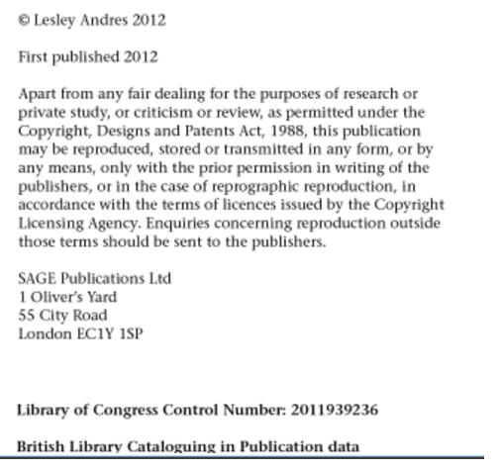
Citation and Referencing
Andres, L. (2012). Designing & Doing Survey Research. Sage.

Slide 17
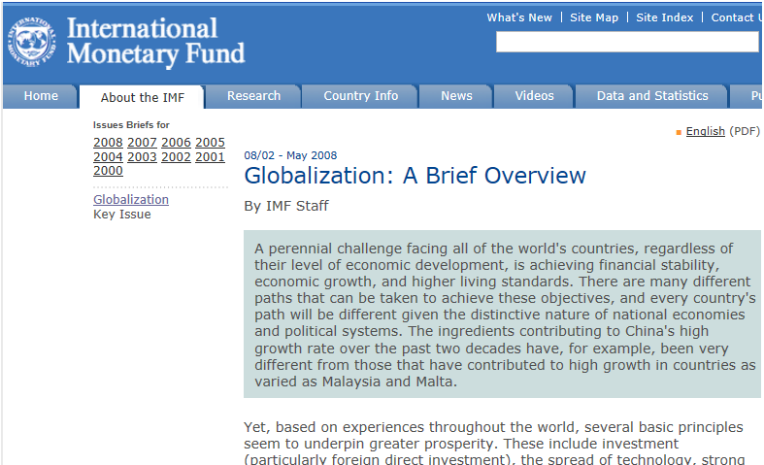
Citation and Referencing
Web page

Slide 18
Citation and Referencing
In-text “Citation” – Web site
International Monetary Fund (2008)
(International Monetary Fund, 2008)
Entry in the list of “References”
Contributors' names (Year). Title. http://
International Monetary Fund (2008). Globalization: A Brief Overview. http://www.imf.org/external/np/exr/ib/2008/053008.htm

Slide 19
Citation and Referencing
Listing the “References”
References must be listed in the alphabetical order (A-Z)
Use “Hanging indent” style (0.5 inch)
Ayoko, O. B., Ang Andrew, A., & Parry, K. (2017). Organizational crisis: emotions and contradictions in managing internal stakeholders. International Journal of Conflict Management, 28(5), 617-643. https://doi.org/10.1108/IJCMA-05-2016-0039
Knight, M. (2020). Pandemic Communication: A New Challenge for Higher Education. Business and Professional Communication Quarterly, 83(2), 131-132. https://doi.org/10.1177/2329490620925418
Smimou, K. (2020). Corporate culture, ethical stimulus, and managerial momentum: Theory and evidence. Business Ethics: A European Review, 29(2), 360-387. https://doi.org/10.1111/beer.12258
A
0.5 inch
0.5 inch
Z
0.5 inch

Slide 20
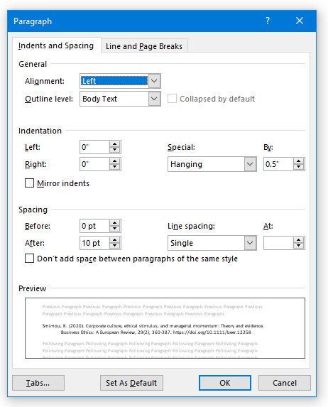
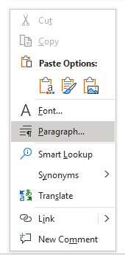
Citation and Referencing
Setting “Hanging indent” style in MS-Word.

Slide 21
Citation and Referencing
Listing the “References”
If the same author published more than one paper in different year, list the references from the oldest to the newest.
Charoensukmongkol, P. (2016). The role of mindfulness on employee psychological reactions to mergers and acquisitions. Journal of Organizational Change Management, 29(5), 816-831. https://doi.org/10.1108/JOCM-05-2015-0068
Charoensukmongkol, P. (2019). The role of mindfulness in reducing English language anxiety among Thai college students. International Journal of Bilingual Education and Bilingualism, 22(4), 414-427. https://doi.org/10.1080/13670050.2016.1264359
The study of Charoensukmongkol (2016, 2019) supported the benefits of mindfulness.
The benefits of mindfulness are found in prior studies (Charoensukmongkol, 2016, 2019).
In-text citation: list all years in the same ( )

Slide 22
Citation and Referencing
Listing the “References”
If the same author published more than one paper in the same year, put “a, b, c…” at the end of the year to separate them and list the references by the alphabetical order of the paper title.
Charoensukmongkol, P. (2014a). Benefits of Mindfulness Meditation on Emotional Intelligence, General Self-Efficacy, and Perceived Stress: Evidence from Thailand. Journal of Spirituality in Mental Health, 16(3), 171-192. https://doi.org/10.1080/19349637.2014.925364
Charoensukmongkol, P. (2014b). Cultural Intelligence and Export Performance of Small and Medium Enterprises in Thailand: Mediating Roles of Organizational Capabilities. International Small Business Journal, 34(1), 1-18. https://doi.org/10.1177/0266242614539364
Charoensukmongkol (2014a, 2014b) previously used PLS-SEM to analyze the data.
PLS-SEM has been frequently used in prior studies (Charoensukmongkol, 2014a, 2014b)
In-text citation: list all years with a, b, c,… in the same ( )

Slide 23
Citation and Referencing
Direct quotation
A direct quotation is a report of the exact words of an author.
Put the direct quoted content inside the “quotation marks” and mention the page number of the document from which the content was taken.

Slide 24
Citation and Referencing
In-text “Citation” - direct quotation
Thomas (2006) suggested that “the concept of intelligence has been notoriously hard to define” (p.79).
OR
Thomas (2006: p.79) suggested that “the concept of intelligence has been notoriously hard to define”.
Note
This method can be use when the content is less than 40 words.

Slide 25
Citation and Referencing
In-text “Citation” – long direct quotation
Place direct quotations that are 40 words or longer in a free-standing block of typewritten lines, and omit quotation marks. Start the quotation on a new line, indented 1/2 inch from the left margin
Example:
Thomas (2006) suggested that:
Social and emotional intelligence share some attributes with CQ such as the idea that intelligence is inherently multidimensional involving behavioral as well as cognitive facets. However, while social and emotional intelligence may be meaningful within one specific cultural setting, they may not apply in another. (p.80).
0.5 inch

Slide 26
EndNote: Referencing software
EndNote is a commercial reference management software package, used to manage bibliographies and references when writing essays and articles
Endnote is “required” for “students who do a “thesis/dissertation”
The software can be requested from the NIDA library:
https://library.nida.ac.th/2015/index.php/th/service/inlibrary/inlibrary/announcement/391-endnote20
Only the “Windows” version can also be downloaded directly from:
https://nida365-my.sharepoint.com/:u:/g/personal/peerayuth_c_nida_ac_th/EYaBCKVxvMVKtWGHmWwMAnkBld-YZ0yB09-rNNEFteMgjA?e=AzPhXG

Slide 27
Assignments
Submit anything to “Turnitin Assignment”
Create citations and references of 3 journal articles (similar to the example).
Deadline: October 7

